Slide 1


SNIPE TEAM
10 January 2018
www.snipe.co.in
1
Notes:
1

Slide 2

Introduction to UML
Introduction
Notes:
Introduce myself

Slide 3
Overview
What is UML?
A brief history of UML
UML-Basic Notations
Why UML for Modeling
UML diagrams with Examples and Code
Notes:
Overview of my presentation:
- Essence of modeling, UML, history of UML, Basics of UML, UML modeling tools

Slide 4
What is UML?
UML …!!
UML stands for “Unified Modeling Language”
It is a industry-standard graphical language for specifying, visualizing, constructing, and documenting the artifacts of software systems
The UML uses mostly graphical notations to express the OO analysis and design of software projects.
It is direct relation with object-oriented analysis and design
Notes:
. What does UML stand for?
. Industry standard
. Graphical notation
. Modeling tool … simplifies software design process

Slide 5
History of UML
History
Notes:
History:
- Rumbaugh – OMT – object modeling technique
Jacobson – OOSE
UML … unified approach since 1995
UML 1.5 current … UML 2.0 by the end of 2004

Slide 6
UML Notations
UML is popular for its diagrammatic notations. We all know that UML is for visualizing, specifying, constructing and documenting the components of software and non-software systems.
UML notations are the most important elements in modeling. Efficient and appropriate use of notations is very important for making a complete and meaningful model.

Slide 7
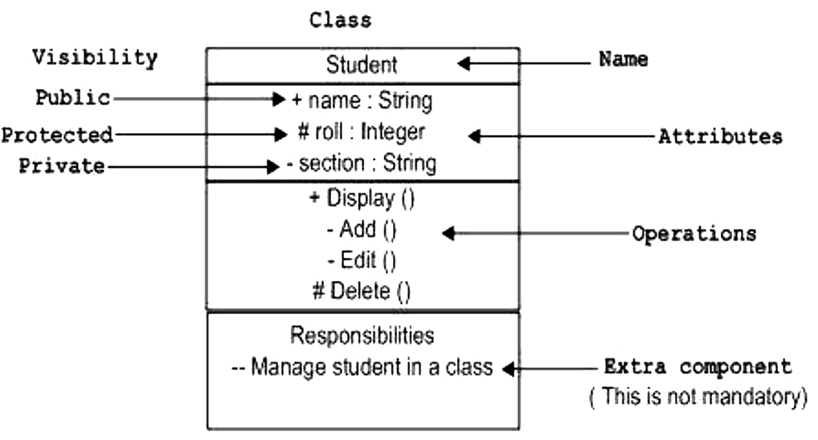
UML Notations
Class Notation :

Slide 8
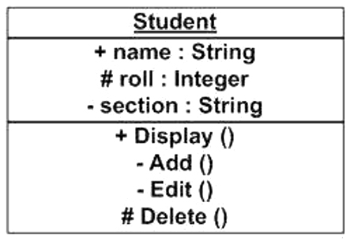
Object Notation
Uml Notations Cont..
As the object is an actual implementation of a class, which is known as the instance of a class. Hence, it has the same usage as the class.

Slide 9
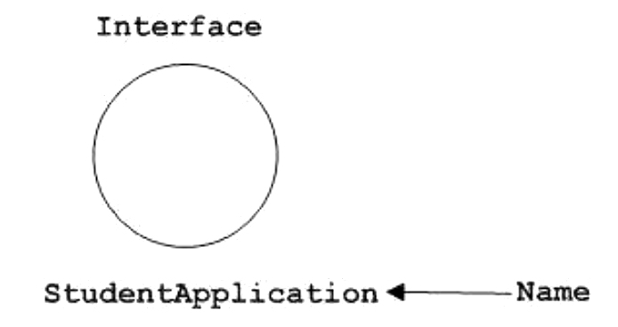
Interface Notation
Uml Notations Cont..
Interface is used to describe the functionality without implementation.
Interface is just like a template where you define different functions, not the implementation.

Slide 10
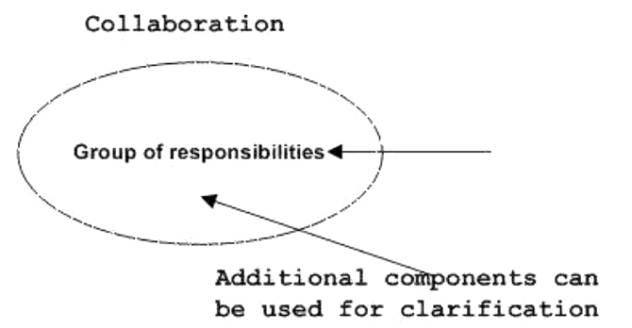
Collaboration Notation
Uml Notations Cont..
A collaboration diagram, also called a communication diagram or interaction diagram, is an illustration of the relationships and interactions among software objects in the Unified Modeling Language (UML)

Slide 11
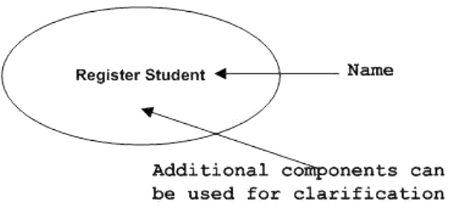
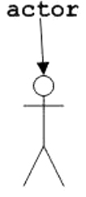
Use Case Notation
Uml Notations Cont..
Actor Notation

Slide 12
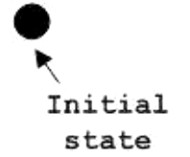
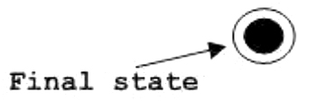
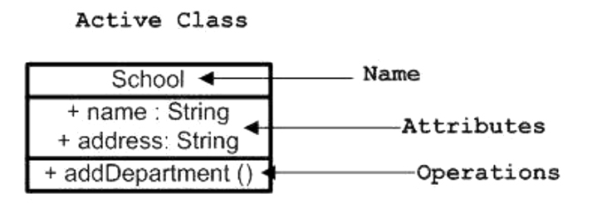
Initial State Notation
Uml Notations Cont..
Final State Notation
Active Class Notation

Slide 13
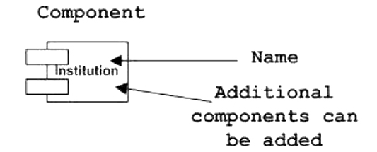
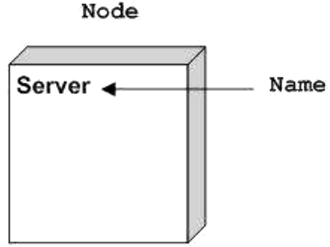
Component Notation
Uml Notations Cont..
Component is used to represent any part of a system for which UML diagrams are made.
Node Notation
Node is used to represent the physical part of a system such as the server, network, etc.

Slide 14
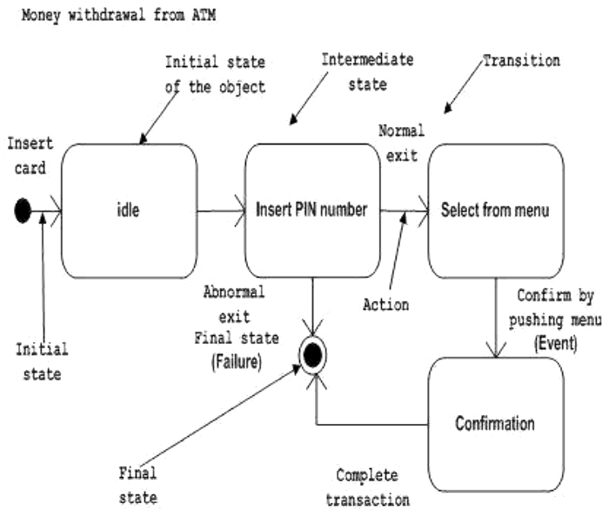
State Machine Notation
Uml Notations Cont..
State machine describes the different states of a component in its life cycle.

Slide 15
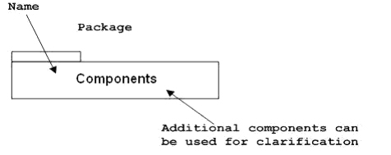
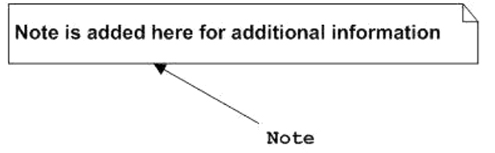
Package Notation
Uml Notations Cont..
Package notation is used to wrap the components of a system.
Note Notation
This notations are used to provide
necessary information of a system.

Slide 16
Dependency Notation
Uml Notations Cont..
Dependency is represented by a dotted arrow as shown in the following figure. The arrow head represents the independent element and the other end represents the dependent element.
Dependent ----------> Independent
Association Notation
Association is used to represent the relationship between two elements of a system.
Employee<----------- Association ----------> Organization

Slide 17
Generalization Notation
Uml Notations Cont..
Generalization describes the inheritance relationship of the object-oriented world. It is a parent and child relationship.

Slide 18
Why UML for Modeling
Use graphical notation to communicate more clearly than natural language (imprecise) and code(too detailed).
Help acquire an overall view of a system.
UML is not dependent on any one language or technology.
The communication of the desired structure and behaviour of a system between analysts, architects, developers, stakeholders and users.
.
Notes:
. More precise than natural language … less detailed than source code
. Not dependent on any language
. Standardized by various groups

Slide 19
Types of UML Diagrams
1) Structural Diagram
-Class Diagram
-Object Diagram
-Component Diagram
-Deployment Diagram
2) Behavioral Diagram
-Use case Diagram
-Sequence Diagram
-Interaction Diagram
-StatechartDiagram
-Activity Diagram

Slide 20
Class diagram
Class diagram is a static diagram. It represents the static view of an application.
Provide a conceptual model of the system in terms of entities and their relationships
Used for requirement capture, end-user interaction
Detailed class diagrams are used for developers
Class diagrams basically represent the object-oriented view of a system

Slide 21
Class representation
Class Diagrams Cont..
Each class is represented by a rectangle subdivided into three compartments
Name
Attributes
Operations
Modifiers are used to indicate visibility of attributes and operations.
‘+’ is used to denote Public visibility (everyone)
‘#’ is used to denote Protected visibility (friends and derived)
‘-’ is used to denote Private visibility (no one)
By default, attributes are hidden and operations are visible.

Slide 22
An example of Class
Class Diagrams Cont..
Car
Class Name
-CarColor : String
-CarPrice : double=0.0
Attributes
Methods/ Opearations
+getCarColor(String): String
+getCarPrice(String): double
public class Car
{ private string CarColur;
private double CarPrice=0.0;
public string getCarColor(String model)
{
return CarColor;
}
public string getCarPrice (String model)
{
return CarPrice;
}
}

Slide 23
Class Diagrams Cont..
The return type of the instance variables or the methods are represented next to the colon (:) sign.
Structure
[visibility] [multiplicity] [:type [=default value]] {property string} Example: carPrice : double = 0.0
Representing Static variable or static operation: The static data is represented with an underline. Let’s take the below example.
Classdiagram : : Employee
-department : String=“Snipe IT”
-empId : int
-Employee(int)
+getDepartment() : String
+getEmployee(int) : String

Slide 24
Class Diagrams Cont..
Code:
public class Employee
{
private static String department = “Snipe IT";
private int empId;
private Employee(int employeeId)
{
this.empId = employeeId;
}
public static String getEmployee(int emplId) {
if (emplId == 1) {
return “snipeemployee";
} else {
return "Employee not found";
}
}
public static String getDepartment() {
return department;
}
}

Slide 25
Association
Class Diagrams Cont..
The association represents the static relationship between two classes along with the multiplicity. E.g. an customer can have one primary address associated with it but can have multiple mobile numbers.
car
Customer
-modelNumber : String
-owner : Customer
-owner
-address : String
-contactNumber : String
-name : String

Slide 26
Code for Association
Class Diagrams Cont..
public class Customer
{
private String name;
private String address;
private String contactNumber;
}
public class Car
{
private String modelNumber;
private Customer owner;
}

Slide 27
Bidirectional
Class Diagrams Cont..
The bidirectional relationship shows that the source object can invoke methods of the destination class.
In Java a possible example can be the instance variable of source class referencing the destination class.
car
Customer
-modelNumber : String
-owner : Customer
-car
-owner
-address : String
-car : Car
-contactNumber : String
-name : String

Slide 28
Code for Bidirectional
Class Diagrams Cont..
public class Customer
{
private String name;
private String address;
private String contactNumber;
private Car car;
}
public class Car
{
private String modelNumber;
private Customer owner;
}

Slide 29
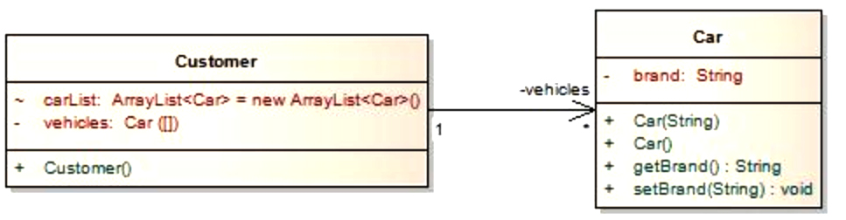
Multiplicity
Class Diagrams Cont..
Assume a scenario where a customer has multiple cars. How do we represent this situation in Java and UML?
Multiplicity in association
The above diagram explains a unidirectional association with a one to may relationship. Both use of ArrayList and Array is for illustration purposes only.

Slide 30
Class Diagrams Cont..
Code for Car.java
public class Car
{
private String brand;
public Car(String brands)
{
this.brand = brands;
}
public Car()
{
}
public String getBrand()
{
return brand;
}
public void setBrand(String brand)
{
this.brand = brand;
}
}

Slide 31
Code for Customer.java
Class Diagrams Cont..
public class Customer
{
private Car[] vehicles;
ArrayList<Car> carList = new ArrayList<Car>();
public Customer()
{
vehicles = new Car[2];
vehicles[0] = new Car("Audi");
vehicles[1] = new Car("Mercedes");
carList.add(new Car("BMW"));
carList.add(new Car("Chevy"));
}
}

Slide 32
OO Relationships
There are two kinds of Relationships
Generalization (parent-child relationship)
Association (student enrolls in course)
Associations can be further classified as
Aggregation
Composition

Slide 33
OO Relationships: Generalization
Supertype
Example:
Customer
Regular
Customer
Loyalty
Customer
Subtype1
Subtype2
or:
Customer
- Generalization expresses a parent/child relationship among related classes.
- Used for abstracting details in several layers
Regular
Customer
Loyalty
Customer

Slide 34
car
-model : String
public class Car
{
}
public class hatchback extends Car
{
}
+getModel() : String
+PrintPrice () : void
+getModel (String) : void
hatch back
-model : String
+getModel() : String
+PrintPrice () : void
+getModel (String) : void

Slide 35
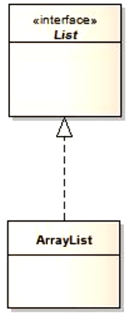
Realization
This is related to the relationship between the class and the interface.
The realization is equivalent to the “implements” keyword in Java.
This is very straight forward implementation so hopefully there will be no code provided unlike Generalization.
ArrayList

Slide 36
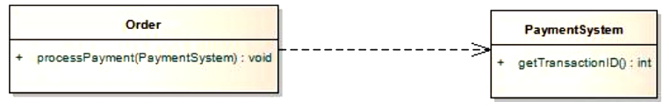
Dependency
Dependency is a relationship that shows that a class is dependent on another class for its existence or
implementation.
public class PaymentSystem {
}
public class Order {
public void processPayment(PaymentSystem ps){
}
}

Slide 37
Aggregation
This shows “has a” relationship. It is a form of association relationship.
This relationship highlights that a whole is made of its parts. So if a whole is destroyed the part still remains.
It is represented through the instance variables of a class.
School
Student
-Student : student
1 0…..*

Slide 38
Aggregation Diagram Cont…
Code:
public class Student {
}
public class School {
private Student student;
}
In this case a student is a part of the School. However during design it is preferred to use association instead of aggregation as it is not a recommended option.

Slide 39
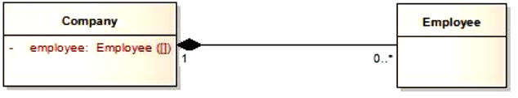
Composition:
The composition is represented as a filled diamond with data flowing in single direction from the whole to the part.
The composition in Java is represented in the same form as aggregation with help of instance variables.
public class Employee {
}
public class Company {
private Employee[] employee;
}

Slide 40
Inheritance : Implements or Extends “Is a”
←------ Dependence : Class Depends on something but it is
not a member or class “uses a”
Association : class contain a reference to another class
“Has a”
Aggregation : class is a container for other classes but if the
container is destroyed is not “owns a”
Composition : class is a container for other classes and if
the container is destroyed the contained is also “Part of”

Slide 41
Object Diagrams
Object Diagrams
Object diagrams are derived from class diagrams so object diagrams are dependent upon class diagrams.
Object diagrams represent an instance of a class diagram. The basic concepts are similar for class diagrams and object diagrams.
Object diagrams are used to render a set of objects and their relationships as an instance.

Slide 42
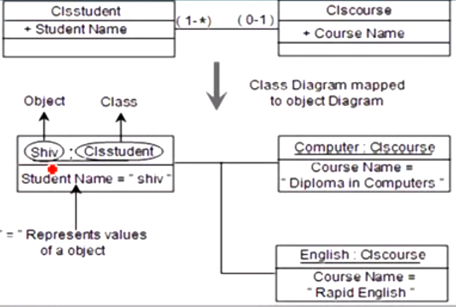
Object Diagrams Cont..

Slide 43
Component Diagrams
Component diagrams are used to model the physical aspects of a system.
Physical aspects are the elements such as executables, libraries, files, documents, etc. which reside in a node.
Purpose of Component Diagrams
Component diagram is a special kind of diagram in UML.
The purpose is also different from all other diagrams discussed so far. It does not describe the functionality of the system but it describes the components used to make those functionalities.

Slide 44
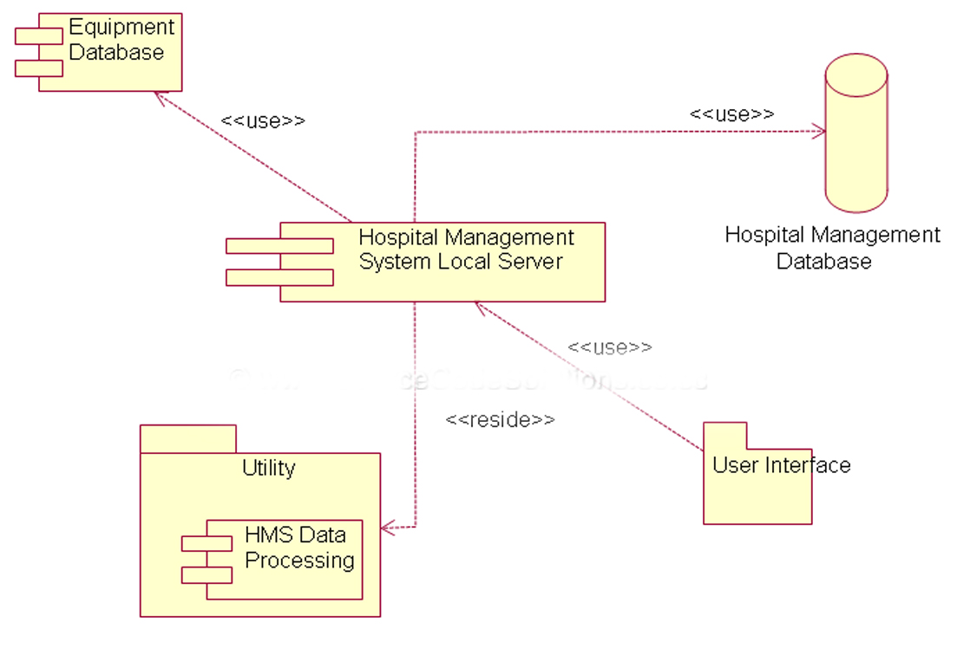
Example for Component Diagram
Component Diagrams

Slide 45
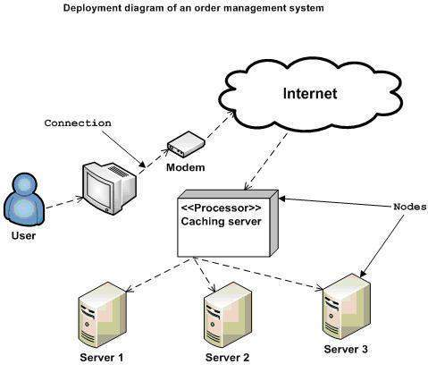
Deployment Diagram
Deployment diagrams are used to visualize the topology of the physical components of a system, where the software components are deployed.

Slide 46
Use Case Diagram
Used for describing a set of user scenarios
Mainly used for capturing user requirements
Work like a contract between end user and software developers

Slide 47
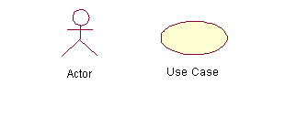
Use Case Diagram (core components)
Actors: A role that a user plays with respect to the system,including human users and other systems. e.g.,inanimate physical objects (e.g. robot); an external system that needs some information from the current system.
Use case: A set of scenarios that describing an interaction between a user and a system, including alternatives.
System boundary: rectangle diagram representing the boundary between the actors and the system.

Slide 48
Use Case Diagram(core relationship)
Association: communication between an actor and a use case; Represented by a solid line.
Generalization: relationship between one general use case and a special use case (used for defining special alternatives)
Represented by a line with a triangular arrow head toward the parent use case.

Slide 49
Use Case Diagram(core relationship)
Include: a dotted line labeled <<include>> beginning at base use case and ending with an arrows pointing to the include use case. The include relationship occurs when a chunk of behavior is similar across more than one use case. Use “include” in stead of copying the description of that behavior.
<<include>>
Extend: a dotted line labeled <<extend>> with an arrow toward the base case. The extending use case may add behavior to the base use case. The base class declares “extension points”.
<<extend>>

Slide 50
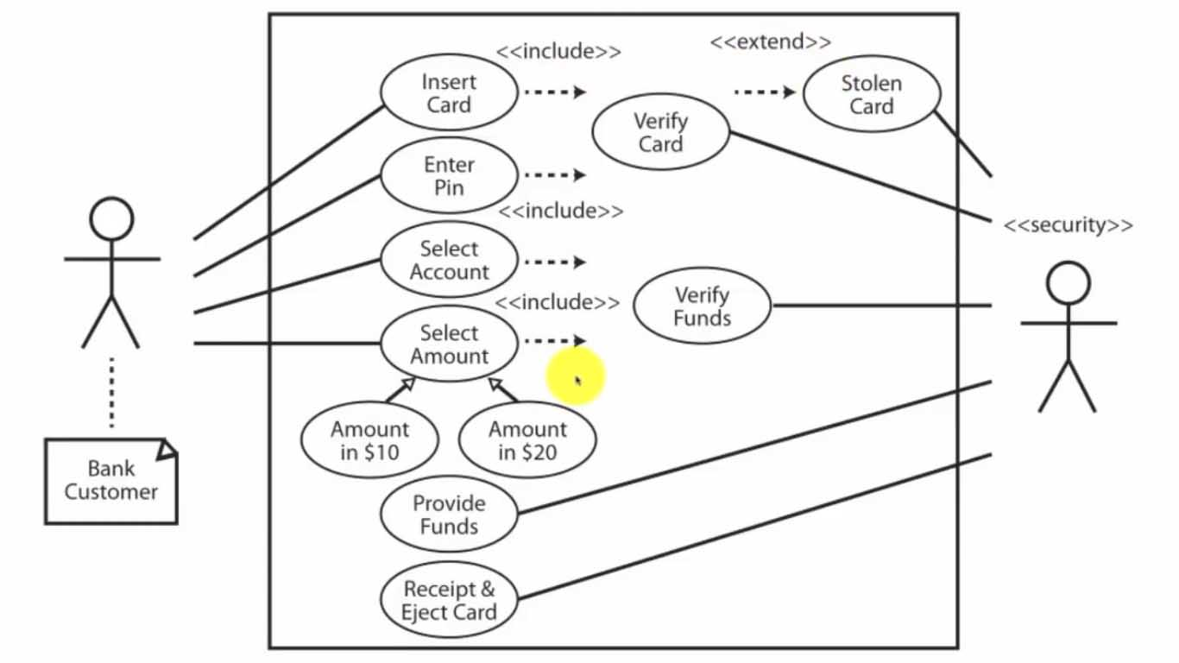
Use Case Diagrams

Slide 51
Steps Of Execution (Requirements)
Use case Diagram
1) Customer Insert Card
a) Card is Invalid
b) Eject Card
2) Card id Validated
3) Customer Enter PIN
a) pin is invalid
b) pin is invalid 3 times
c) card is marked as stolen
4) PIN is validated
5) Account is selected
6) Amount is selected
a) over daily limit
b) over Account Funds available
7) Provide 500 or 2000
8) Provide Funds
9) Provide Receipt
10) Eject Card

Slide 52
Sequence Diagram(make a phone call)
Sequence diagram is an Interaction diagram that shows how objects operate with one another & in what order
Caller
Phone
Recipient
Picks up
Dial tone
Dial
Ring notification
Ring
Picks up
Hello

Slide 53
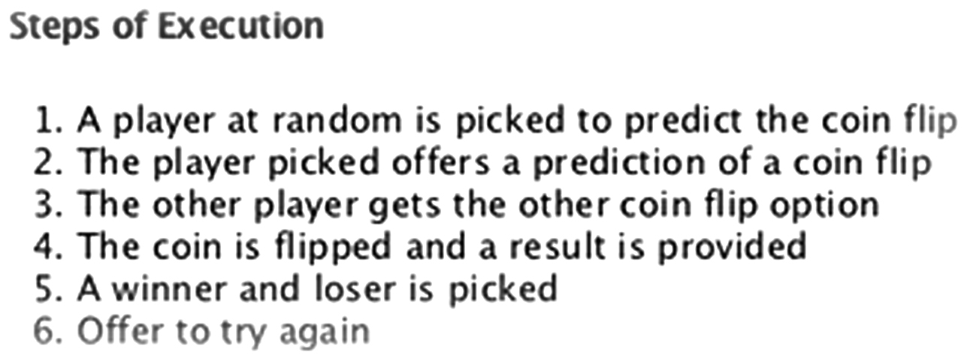
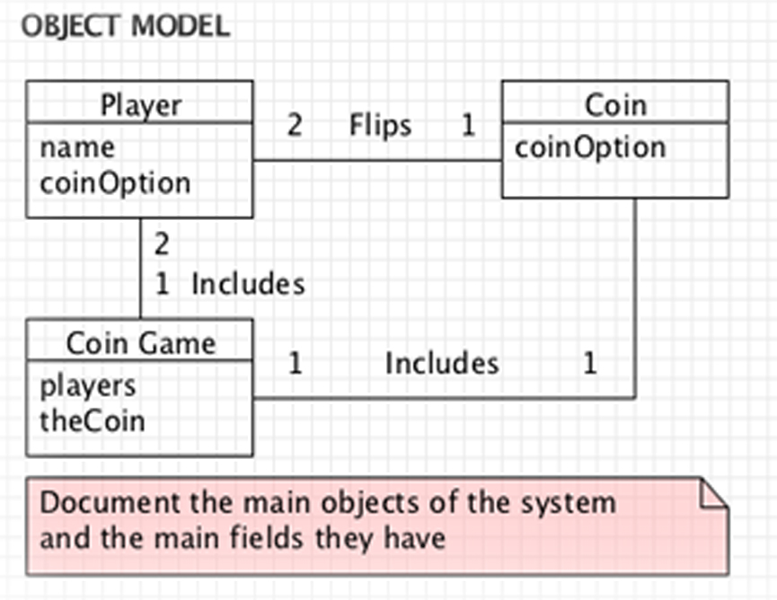
Sequence Diagram
Example for Sequence Digram and Class Diagram Coin Game:

Slide 54
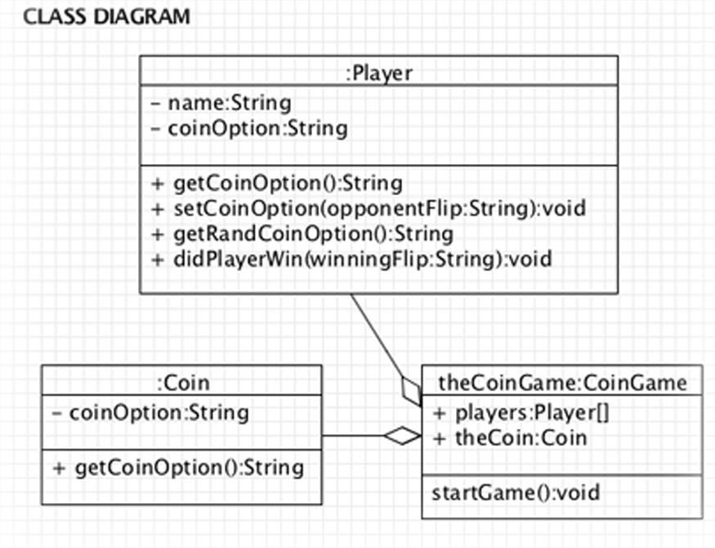
Sequence Diagram

Slide 55
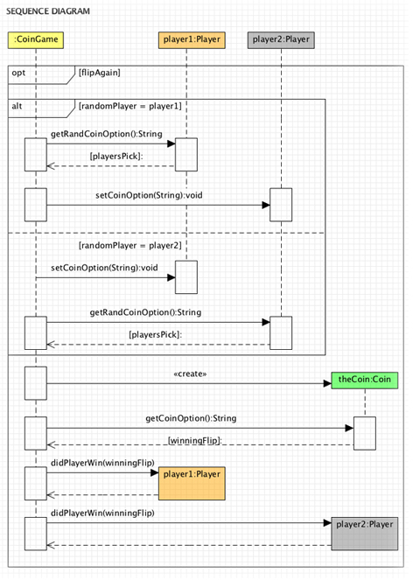
Sequence Diagram

Slide 56
Interaction Diagrams: Collaboration diagrams
In the collaboration diagram, the method call sequence is indicated by some numbering technique. The number indicates how the methods are called one after another. We have taken the same order management system to describe the collaboration diagram.
To choose between these two diagrams, emphasis is placed on the type of requirement. If the time sequence is important, then the sequence diagram is used. If organization is required, then collaboration diagram is used.

Slide 57
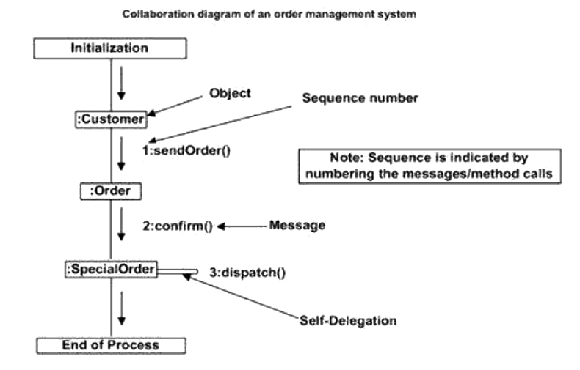

Slide 58
Statechart Diagrams
Statechart diagram define different states of an object during its lifetime and these states are changed by events.
Statechart diagram describes the flow of control from one state to another state
Before drawing a Statechart diagram we should clarify the following points:
Identify the important objects to be analyzed
Identify the states
Identify the events

Slide 59

Statechart Diagram
Example:

Slide 60
State Diagrams (Traffic light example)
Statechart Diagram
Traffic Light
Start
State
Red
Transition
Yellow timer expires
Car trips sensor
Yellow
Green timer expires
Green
Event

Slide 61
Activity diagram
Activity diagram is basically a flowchart to represent the flow from one activity to another activity. The activity can be described as an operation of the system.
Purpose of Activity Diagrams
activity diagram is used to show message flow from one activity to another.
Before drawing an activity diagram, we should identify the following elements:
Activities
Association
Conditions
Constraints

Slide 62
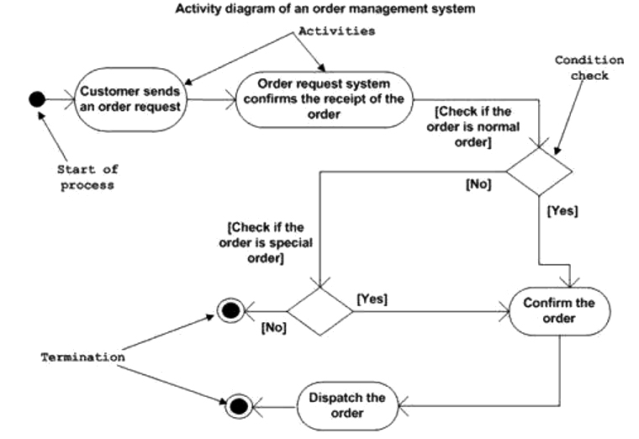
Activity Diagram
Example for Activity Diagram
Following diagram is drawn with the four main activities:
Send order by the customer
Receipt of the order
Confirm the order
Dispatch the order

Slide 63


